Slide 1
When to use What – Azure Services
Sastry Kolachina
Partner Technology Strategist, Asia Pacific
Microsoft

Slide 2
Update Log
Last Updated: 02 Sep 2019
Reviewed and Updated product slides for IaaS
New Slides
Slide 11 - Storage Durability
Slide 15 - Choose the right virtual networking architectures
Slide 27: Choosing a Data Store
Slide 28 - 32: Azure Data Migration Tools

Slide 3
IaaS Decision Making Guide Compute, Network and Storage

Slide 4
Which Compute Product To Use?
IF YOU WANT TO... | USE THIS
Provision Linux and Windows virtual machines in seconds with the configurations of your choice | Virtual Machines
Achieve high availability by autoscaling to create thousands of VMs in minutes | Virtual Machine Scale Sets
Simplify the deployment, management, and operations of Kubernetes | Azure Kubernetes Service (AKS)
Accelerate app development using an event-driven, serverless architecture | Azure Functions
Develop microservices and orchestrate containers on Windows and Linux | Service Fabric
Quickly create cloud apps for web and mobile with fully managed platform | App Service
Containerize apps and easily run containers with a single command | Container Instances
Cloud-scale job scheduling and compute management with the ability to scale to tens, hundreds, or thousands of virtual machines | Batch
Create highly available, scalable cloud applications and APIs that help you focus on apps instead of hardware | Cloud Services
Deploy your Azure virtual machines on a physical server only used by your organization | Azure Dedicated Host
https://azure.microsoft.com/en-us/product-categories/compute/

Slide 5
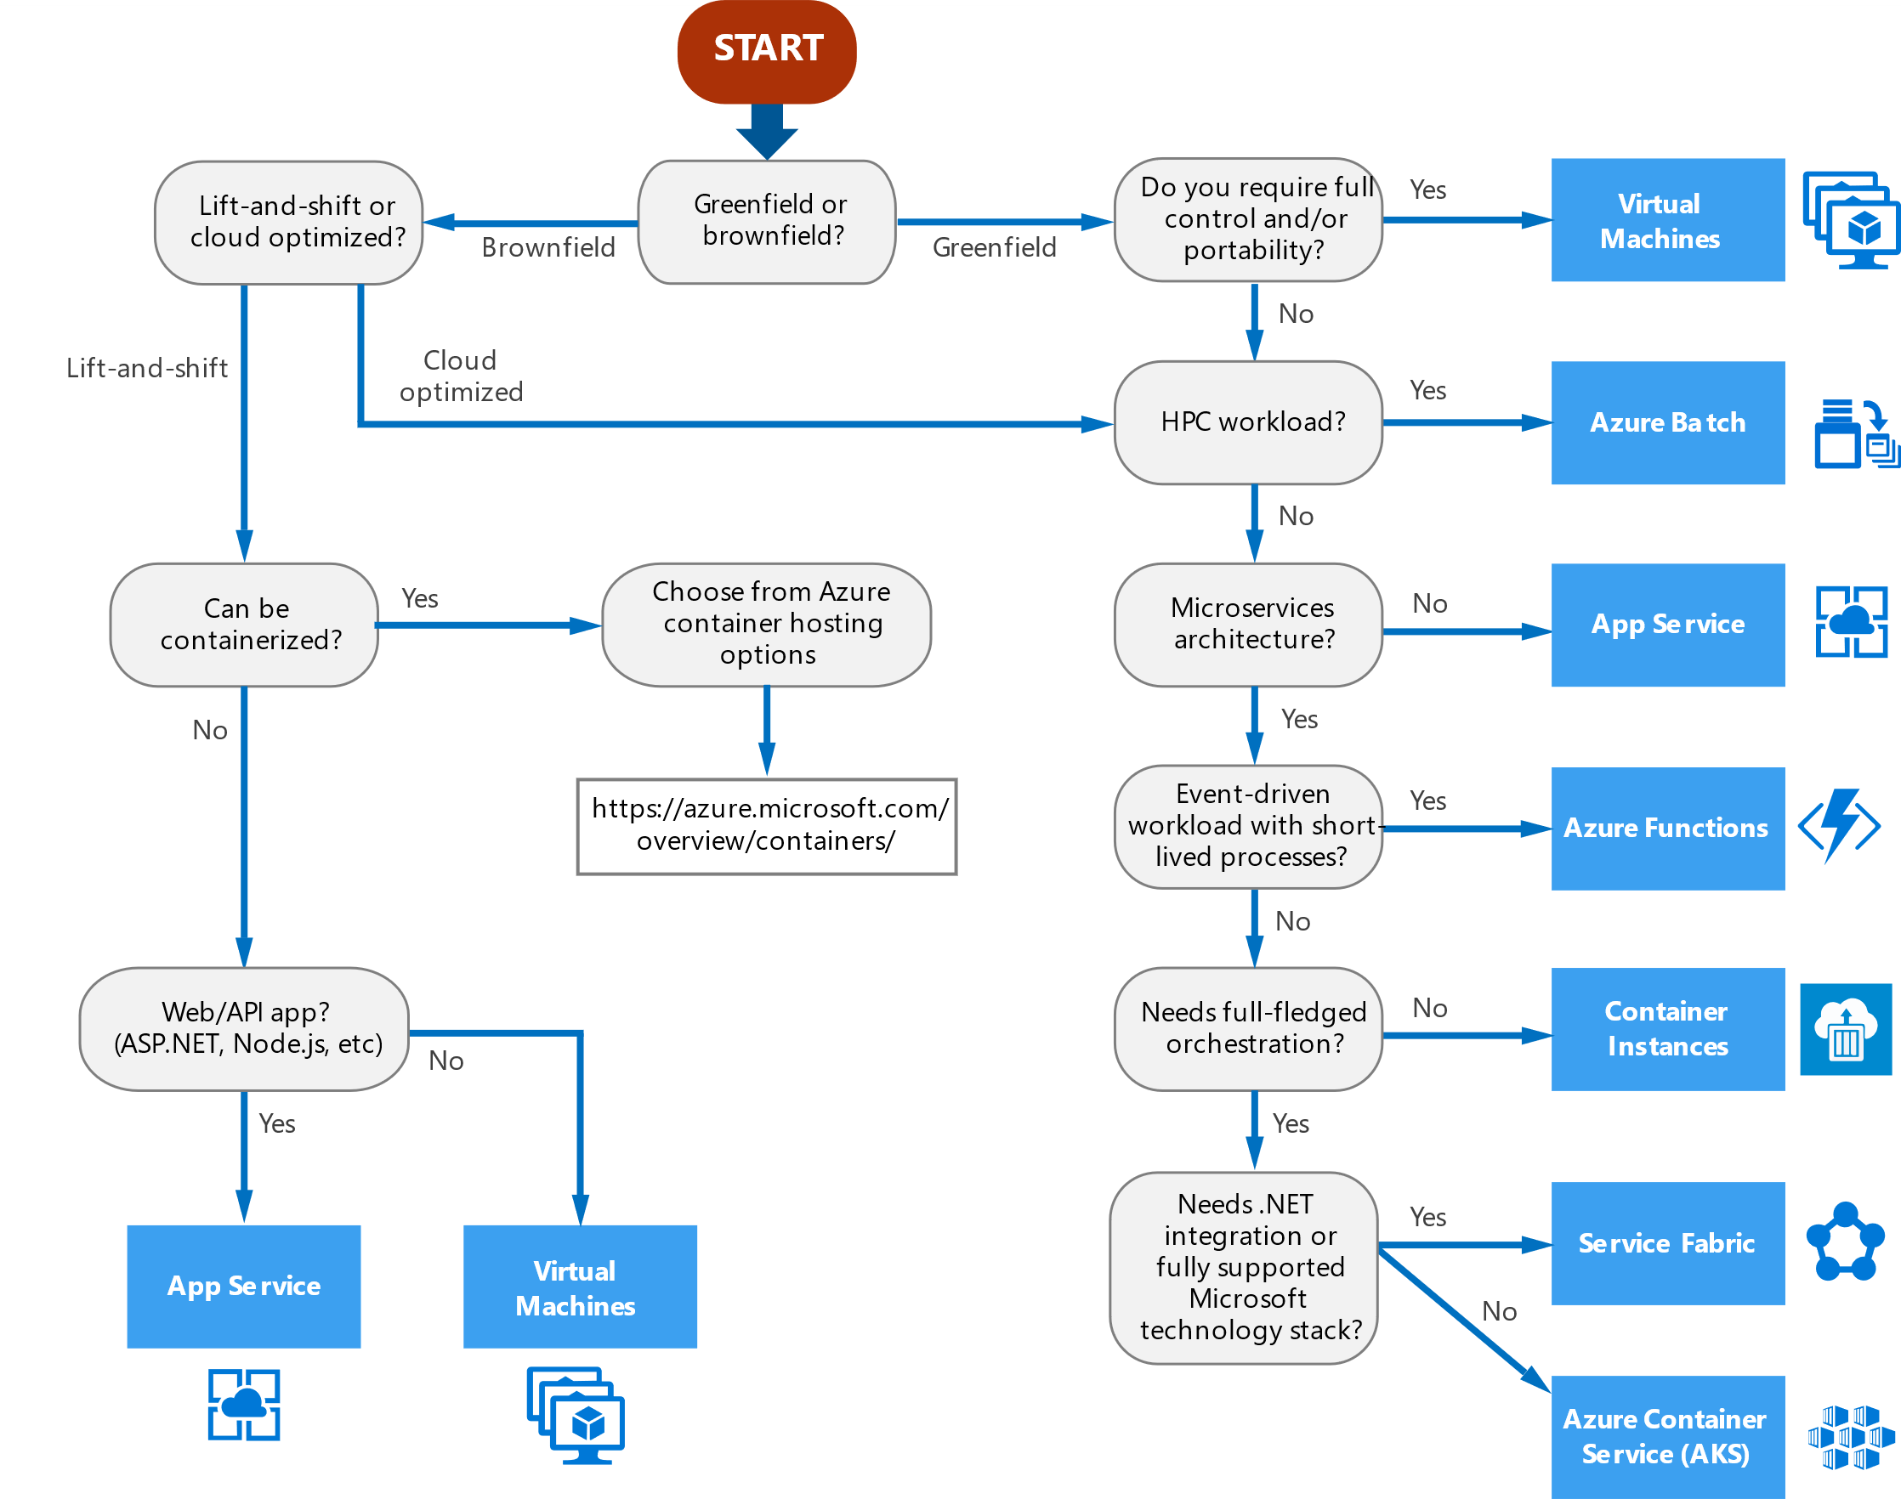
Decision tree for Azure compute services Where to place your workload?
https://docs.microsoft.com/en-us/azure/architecture/guide/technology-choices/compute-decision-tree

Slide 6
Criteria for choosing an Azure compute service Hosting Model
Criteria | Virtual Machines | App Service | Service Fabric | Azure Functions | Azure Kubernetes Service | Container Instances | Azure Batch
Application composition | Agnostic | Applications, containers | Services, guest executables, containers | Functions | Containers | Containers | Scheduled jobs
Density | Agnostic | Multiple apps per instance via app service plans | Multiple services per VM | Serverless ¹ | Multiple containers per node | No dedicated instances | Multiple apps per VM
Minimum number of nodes | 1 ² | 1 | 5 ³ | Serverless ¹ | 3 ³ | No dedicated nodes | 1 ⁴
State management | Stateless or Stateful | Stateless | Stateless or stateful | Stateless | Stateless or Stateful | Stateless | Stateless
Web hosting | Agnostic | Built in | Agnostic | Not applicable | Agnostic | Agnostic | No
Can be deployed to dedicated VNet? | Supported | Supported⁵ | Supported | Supported ⁵ | Supported | Not supported | Supported
Hybrid connectivity | Supported | Supported ⁶ | Supported | Supported ⁷ | Supported | Not supported | Supported
https://docs.microsoft.com/en-us/azure/architecture/guide/technology-choices/compute-comparison

Slide 7
Criteria for choosing an Azure compute service Scalability
Criteria | Virtual Machines | App Service | Service Fabric | Azure Functions | Azure Kubernetes Service | Container Instances | Azure Batch
Autoscaling | Virtual machine scale sets | Built-in service | Virtual machine scale sets | Built-in service | Not supported | Not supported | N/A
Load balancer | Azure Load Balancer | Integrated | Azure Load Balancer | Integrated | Integrated | No built-in support | Azure Load Balancer
Scale limit¹ | Platform image: 1000 nodes per VMSS, Custom image: 100 nodes per VMSS | 20 instances, 100 with App Service Environment | 100 nodes per VMSS | 200 instances per Function app | 100 nodes per cluster (default limit) | 20 container groups per subscription (default limit). | 20 core limit (default limit).

Slide 8
Which Storage Product To Use?
IF YOU WANT TO... | USE THIS
Get scalable and secure storage for your virtual machines | Disk Storage
Find massively scalable, secure storage for your unstructured data | Blob Storage
Get low-cost storage for rarely accessed data | Archive Storage
Get secure cloud file shares | File Storage
Run high-performance, file-based workloads in the cloud | Avere vFXT for Azure
Get secure storage for message-based communication between apps | Queue Storage
Appliances and solutions for data transfer to Azure and edge compute | Data Box
Create powerful file shares for enterprise workloads, including open-source/Linux | Azure NetApp Files
https://azure.microsoft.com/en-us/product-categories/storage/
Notes:
https://azure.microsoft.com/en-us/product-categories/storage/

Slide 9
Azure Storage - Files vs. Blobs vs. Disks
Feature | Description | When to use
Azure Files | Provides an SMB interface, client libraries, and a REST interface that allows access from anywhere to stored files. | You want to "lift and shift" an application to the cloud which already uses the native file system APIs to share data between it and other applications running in Azure. You want to store development and debugging tools that need to be accessed from many virtual machines.
Azure Blobs | Provides client libraries and a REST interfacethat allows unstructured data to be stored and accessed at a massive scale in block blobs. Also supports Azure Data Lake Storage Gen2 for enterprise big data analytics solutions. | You want your application to support streaming and random-access scenarios. You want to be able to access application data from anywhere. You want to build an enterprise data lake on Azure and perform big data analytics.
Azure Disks | Provides client libraries and a REST interfacethat allows data to be persistently stored and accessed from an attached virtual hard disk. | You want to lift and shift applications that use native file system APIs to read and write data to persistent disks. You want to store data that is not required to be accessed from outside the virtual machine to which the disk is attached.
Above table compares Files, Blobs, and Disks, and shows example scenarios appropriate for each

Slide 10
Selecting durability options for your storage needs
Scenario | Locally redundant storage | Geo-redundant storage | Read Access geo-redundant storage | Zone-redundent storage | Geo Zone Redundant Storage | Read Access Geo Zone Redundant Storage
Node unavailability within a data center | Yes
An entire data center (zonal or non-zonal) becomes unavailable | No | Yes (failover is required) |  | Yes | Yes
A region-wide outage | No | Yes (failover is required) |  | No | Yes (failover is required)
Read access to your data (in a remote, geo-replicated region) in the event of region-wide unavailability | No | No | Yes | No | No | Yes
Designed to provide X% durability of objects over a given year | at least 11 9's | at least 16 9's |  | at least 12 9's | at least 16 9's
Supported storage account types | GPv2, GPv1, Blob |  |  | GPv2
Availability SLA for read requests | At least 99.9% (99% for Cool Access Tier) |  | At least 99.99% (99.9% for Cool Access Tier) | At least 99.9% (99% for cool access tier) |  | At least 99.99% (99.9% for Cool Access Tier)
Availability SLA for write requests | At least 99.9% (99% for Cool Access Tier)
Notes:
https://azure.microsoft.com/en-us/blog/geo-zone-redundant-storage-in-azure-now-in-preview/

Slide 11
Which Networking Product To Use?
IF YOU WANT TO... | USE THIS
Connect everything from virtual machines to incoming VPN connections | Virtual Network
Balance inbound and outbound connections and requests to your applications or service endpoints | Load Balancer
Optimize delivery from application server farms while increasing application security with a web application firewall | Application Gateway
Securely use the internet to access Azure Virtual Networks with high performance VPN gateways | VPN Gateway
Ensure ultra-fast DNS responses and ultra-high availability for all your domain needs | Azure DNS
Accelerate the delivery of high-bandwidth content to customers worldwide—from applications and stored content to streaming video | Content Delivery Network
Protect your Azure applications from the impacts of DDoS attacks | Azure DDoS Protection
Distribute traffic optimally to services across global Azure regions, while providing high availability and responsiveness | Traffic Manager
Add private network connectivity to access Microsoft cloud services from your corporate networks, as if they were on-premises residing in your own datacenter | ExpressRoute
Monitor and diagnose conditions at a network scenario level | Network Watcher
Native firewalling capabilities with built-in high availability, unrestricted cloud scalability, and zero maintenance | Azure Firewall
Connect business offices, retail locations, and sites securely with Virtual WAN, a unified wide-area network portal powered by Azure and the Microsoft global network | Virtual WAN
Scalable, security-enhanced delivery point for global, microservice-based web applications | Azure Front Door Service
Private and fully managed RDP and SSH access to your virtual machines | Azure Bastion
https://azure.microsoft.com/en-us/product-categories/networking/

Slide 12
Choose the right Virtual Networking architectures
Question | PaaS-only | Cloud-native | Cloud DMZ | Hybrid | Hub and spoke
Will your workload only use PaaS services and not require networking capabilities beyond those provided by the services themselves? | Yes | No | No | No | No
Does your workload require integration with on-premises applications? | No | No | Yes | Yes | Yes
Have you established mature security policies and secure connectivity between your on-premises and cloud networks? | No | No | No | Yes | Yes
Does your workload require authentication services not supported through cloud identity services, or do you need direct access to on-premises domain controllers? | No | No | No | Yes | Yes
Will you need to deploy and manage a large number of VMs and workloads? | No | No | No | No | Yes
Will you need to provide centralized management and on-premises connectivity while delegating control over resources to individual workload teams? | No | No | No | No | Yes
Notes:
https://docs.microsoft.com/en-us/azure/architecture/cloud-adoption/decision-guides/software-defined-network/index

Slide 13
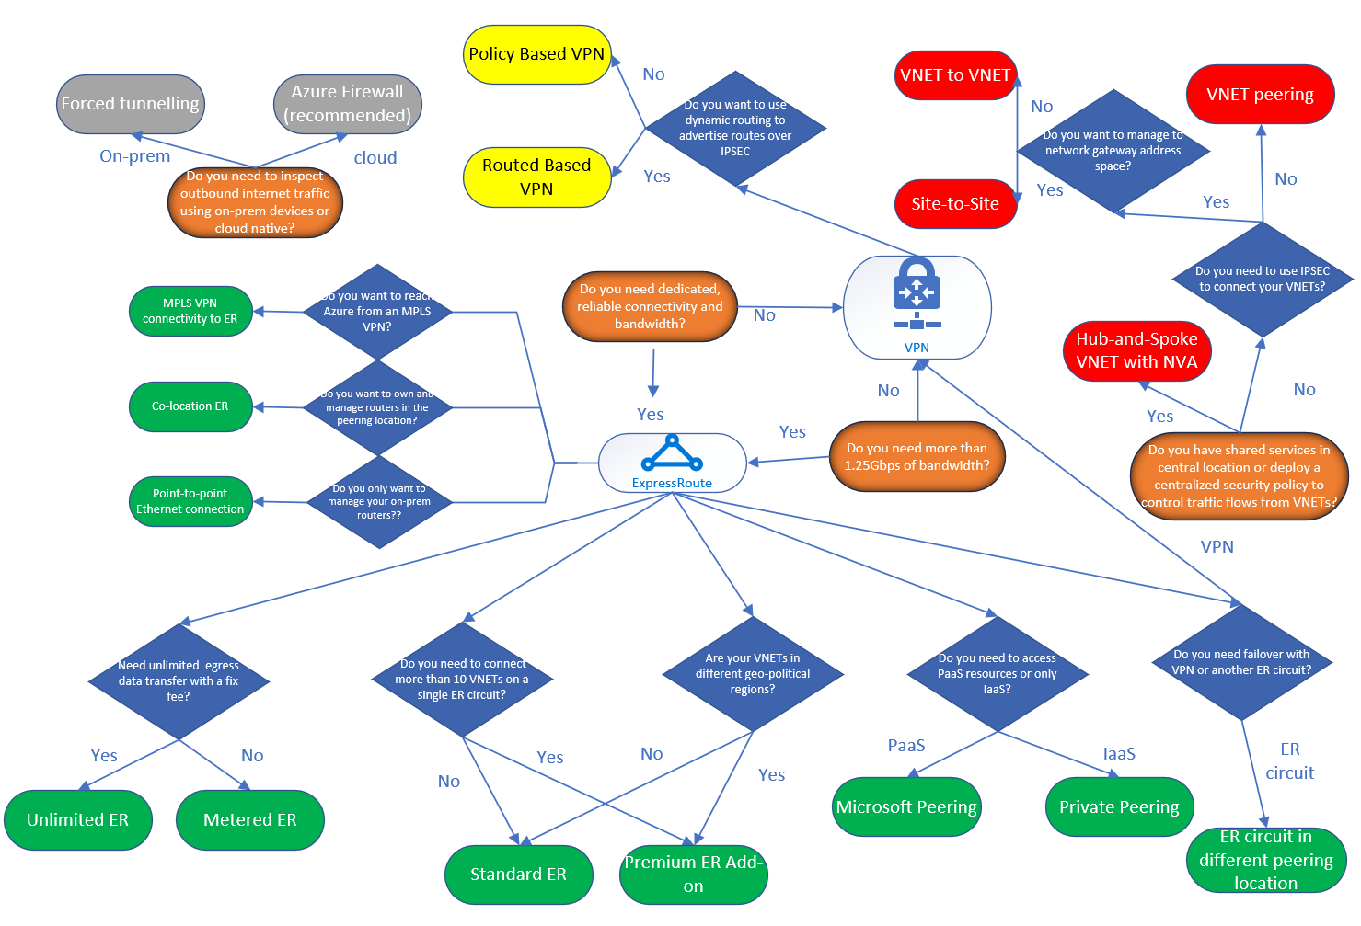
Decision Tree for Azure Networking Solutions
https://blogs.msdn.microsoft.com/ukhybridcloud/2018/09/12/a-decision-tree-for-azure-networking/
Notes:
https://techcommunity.microsoft.com/t5/ITOps-Talk-Blog/What-is-the-difference-between-Azure-Application-Gateway-Load/ba-p/572912

Slide 14
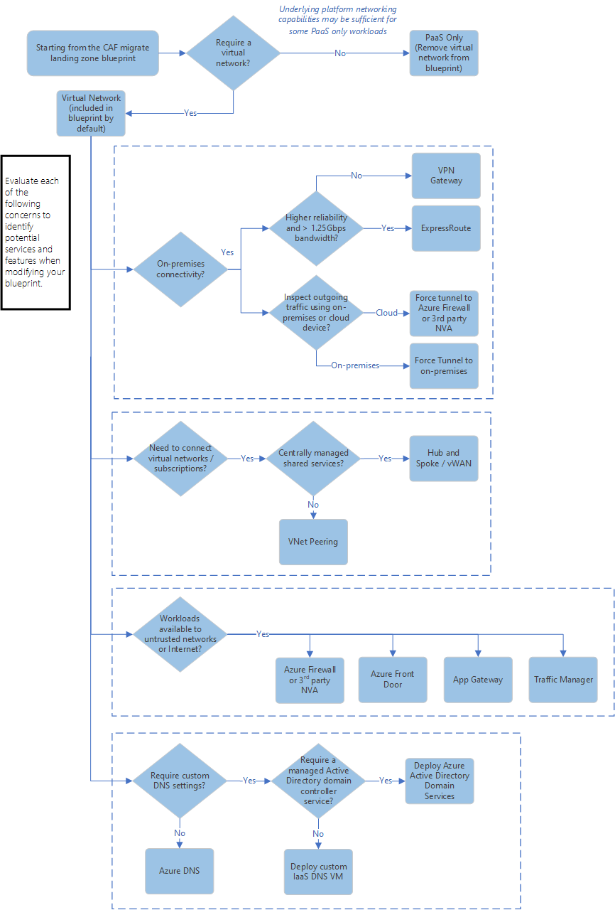
Identify networking requirements for workloads
https://docs.microsoft.com/en-us/azure/architecture/cloud-adoption/ready/considerations/network-decisions
Notes:
https://docs.microsoft.com/en-us/azure/architecture/cloud-adoption/ready/considerations/network-decisions

Slide 15
Security , Identity, Governance and Management

Slide 16
Azure Security, Management and Governance
MIGRATE
Azure Site Recovery, Azure Migrate Tool and Partner Solutions
GOVERN
SECURE
Policy management with Azure Policy Management
Cost management with Azure Cost Management
Security management with Azure Security Center and Azure Key Vault
Threat protection with Azure ATP
CONFIGURE
Microsoft Azure
PROTECT
Process, Configuration, VM Update management
Automation, Scripting with Azure Automation, DSC and Update Management
Azure Backup
Disaster recovery with Azure Site Recovery, Azure Backup Services
MONITOR
App, Infra & Network monitoring, Log Analytics and Diagnostics with Azure Monitor

Slide 17
Which Security Product To Use?
IF YOU WANT TO... | USE THIS
Unify security management and enable advanced threat protection for workloads in the cloud and on-premises | Security Center
Safeguard cryptographic keys and other secrets used by cloud apps and services | Key Vault
Protect your Azure resources from denial of service threats | Azure DDoS Protection
Control and help secure email, documents, and sensitive data that you share outside your company | Azure Information Protection
Protect your applications from common web vulnerabilities and exploits with a built-in web application firewall | Application Gateway
https://azure.microsoft.com/en-us/product-categories/security/

Slide 18
Management and Governance – Which Products to Use?
Management tools for monitoring | USE THIS
Get visibility into the status of Azure platform components | Azure Monitor
Collect, search, and visualize machine data from on-premises and cloud | Log Analytics
Monitor and diagnose network issues | Network Watcher
Management tools for configuration | USE THIS
Automate, configure, and update your resources | Automation
Get personalized recommendations to help manage your Azure environment | Azure Advisor
Deploy and manage your Azure resources | Azure Resource Manager
Create, maintain, and invoke scheduled work for your apps | Scheduler
Route incoming traffic for better performance and availability | Traffic Manager
Manage Azure using a command-line experience | Cloud Shell
Manage deployed solutions for your customers | Azure Managed Applications
Personalize and manage your Azure environment | Microsoft Azure portal
Stay connected to your Azure resources from anywhere at anytime | Azure mobile app
Empowering service providers to manage customers at scale and with precision | Azure Lighthouse

Slide 19
Management and Governance – Which Products to Use?
Management tools for governance | USE THIS
Get transparency into what you’re spending on cloud resources | Cost Management
Set policies across resources and monitor compliance | Azure Policy
Enabling quick, repeatable creation of governed environments | Azure Blueprints
Management tools for security and protection | USE THIS
Back up your resources and protect against data loss | Azure Backup
Deliver highly available virtual machines with built-in disaster recovery | Azure Site Recovery
Secure your resources and protect against threats | Security Center

Slide 20
Identity and Access Management – Choosing the Right Product?
IF YOU WANT TO... | USE THIS
Provide identity and access management for cloud and hybrid environments | Azure Active Directory
Manage and protect customer identities and access in the cloud using IAM security features | Azure Active Directory B2C
Join virtual machines in Azure to a domain without deploying domain controllers | Azure Active Directory Domain Services

Slide 21
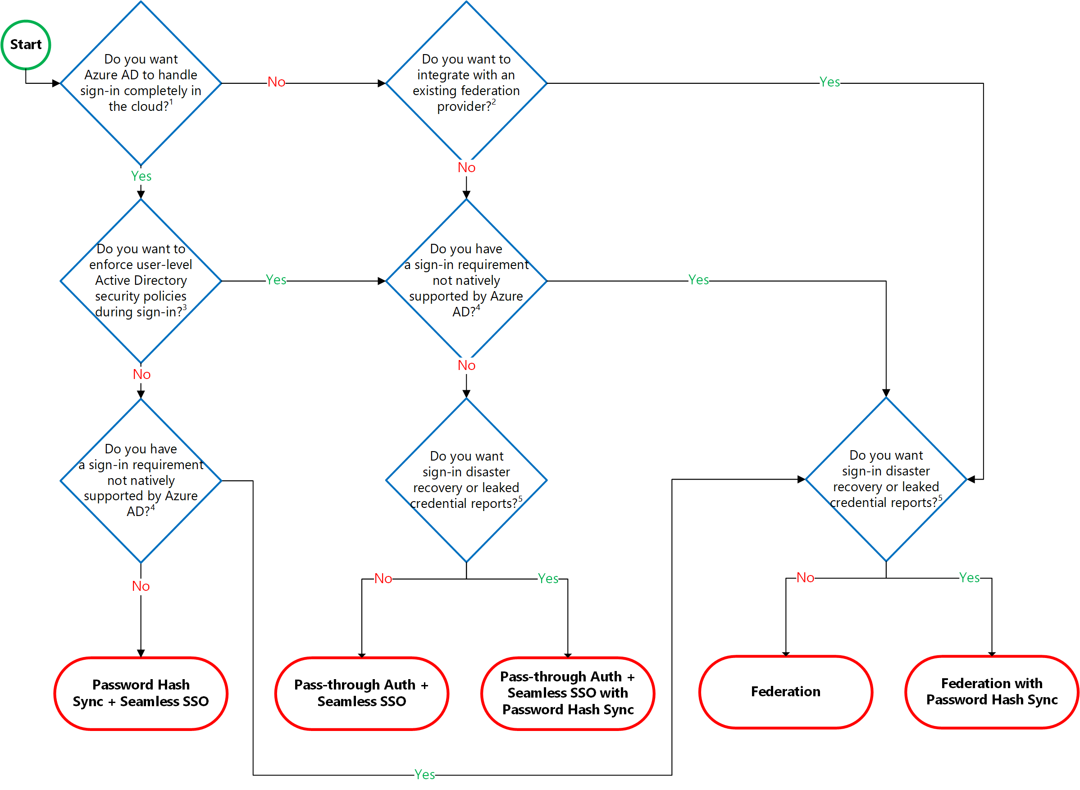
Choosing the Right Authentication Model
https://docs.microsoft.com/en-in/azure/security/azure-ad-choose-authn
Notes:
https://docs.microsoft.com/en-in/azure/security/azure-ad-choose-authn
Identity Baseline Tools
https://docs.microsoft.com/en-us/azure/architecture/cloud-adoption/governance/identity-baseline/toolchain
Identity Baseline is one of the Five Disciplines of Cloud Governance. This discipline focuses on ways of establishing policies that ensure consistency and continuity of user identities regardless of the cloud provider that hosts the application or workload.
Selecting Right Auth Model with AAD
https://youtu.be/YtW2cmVqSEw

Slide 22
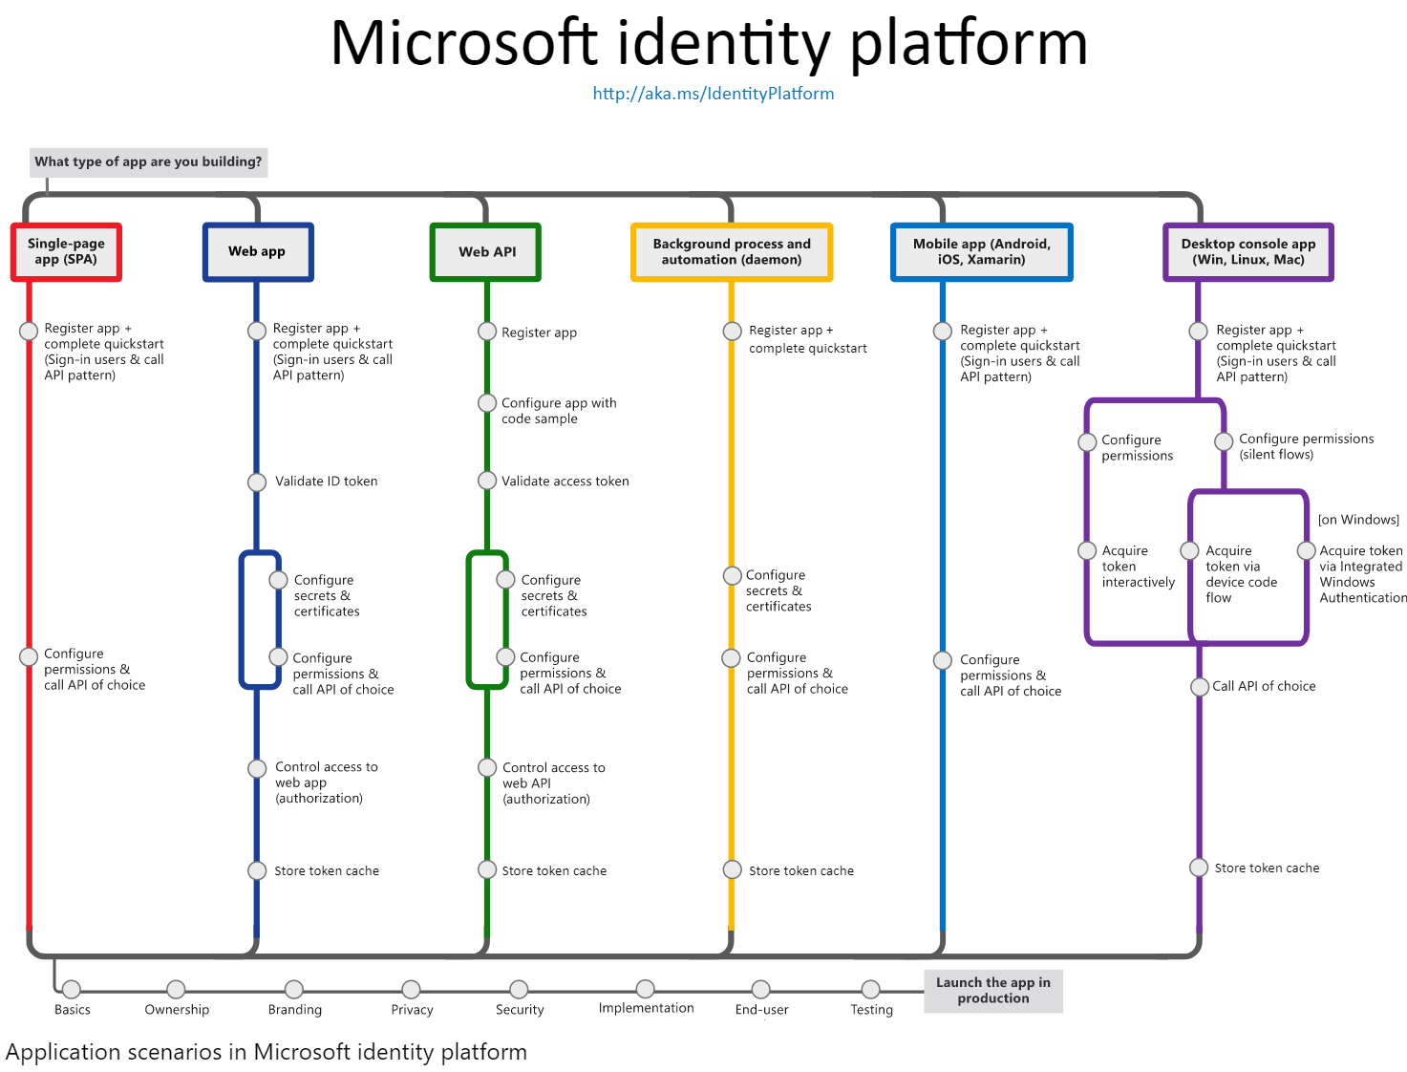

Slide 23
Which Azure Database Product To Use?
IF YOU WANT... | USE THIS
A globally distributed multi-model database, with support for NoSQL choices, with industry-leading performance and SLAs | Azure Cosmos DB
A fully managed relational database that provisions quickly, scales on the fly, and includes built-in intelligence and security | Azure SQL Database
A fully managed, scalable MySQL relational database with high availability and security built in at no extra cost | Azure Database for MySQL
A fully managed, scalable PostgreSQL relational database with high availability and security built in at no extra cost | Azure Database for PostgreSQL
To host enterprise SQL Server apps in the cloud | SQL Server on Virtual Machines
A fully managed, elastic data warehouse with security at every level of scale at no extra cost | SQL Data Warehouse
Help migrating your databases to the cloud with no application code changes | Azure Database Migration Service
High throughput and consistent low-latency data access to power fast, scalable applications | Azure Cache for Redis
A NoSQL key-value store for rapid development using massive semi-structured datasets | Table Storage
A fully managed, scalable MariaDB relational database with high availability and security built in at no extra cost | Azure Database for MariaDB
https://azure.microsoft.com/en-us/product-categories/databases/
Notes:
https://azure.microsoft.com/en-us/product-categories/databases/

Slide 24
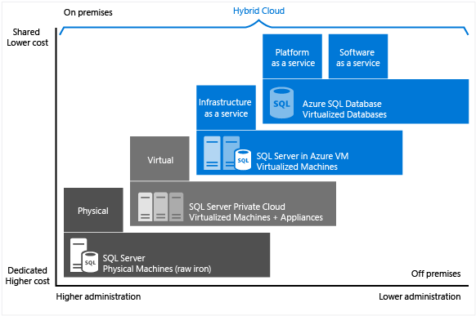
Choose the right SQL Server option in Azure
Choose the right SQL Server option in Azure

Slide 25
Choose the right SQL Server option in Azure
SQL Server on VM | Managed instance in SQL Database | Single database / elastic pool in SQL Database
You have full control over the SQL Server engine. Up to 99.95% availability. Full parity with the matching version of on-premises SQL Server. Fixed, well-known database engine version. Easy migration from SQL Server on-premises Private IP address within Azure Vnet You have ability to deploy application or services on the host where SQL Server is placed | High compatibility with SQL Server on-premises 99.99% availability guaranteed Built-in backups, patching, recovery Latest stable Database Engine version Easy migration from SQL Server Private IP address within Azure Vnet Built-in advanced intelligence and security Online change of resources (CPU/storage). | The most commonly used SQL Server features are available 99.99% availability guaranteed Built-in backups, patching, recovery Latest stable Database Engine version Ability to assign necessary resources (CPU/storage) to individual databases Built-in advanced intelligence and security Online change of resources (CPU/storage).
You need to manage your backups and patches You need to implement your own High-Availability solution There is a downtime while changing the resources(CPU/storage) | There is still some minimal number of SQL Server features that are not available No guaranteed exact maintenance time (but nearly transparent) Compatibility with the SQL Server version can be achieved only using database compatibility levels. | Migration from SQL Server might be hard Some SQL Server features are not available No guaranteed exact maintenance time (but nearly transparent) Compatibility with the SQL Server version can be achieved only using database compatibility levels Private IP address cannot be assigned (you can limit the access using firewall rules).
https://docs.microsoft.com/en-us/azure/sql-database/sql-database-paas-vs-sql-server-iaas#business-motivations-for-choosing-azure-sql-database-or-sql-server-on-azure-vms

Slide 26
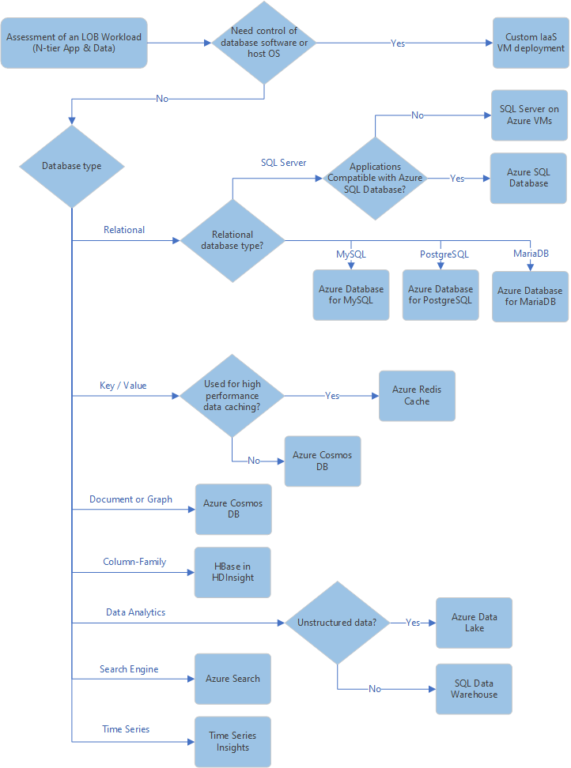
Choosing a Data Store

Slide 27
Migration Tools

Slide 28
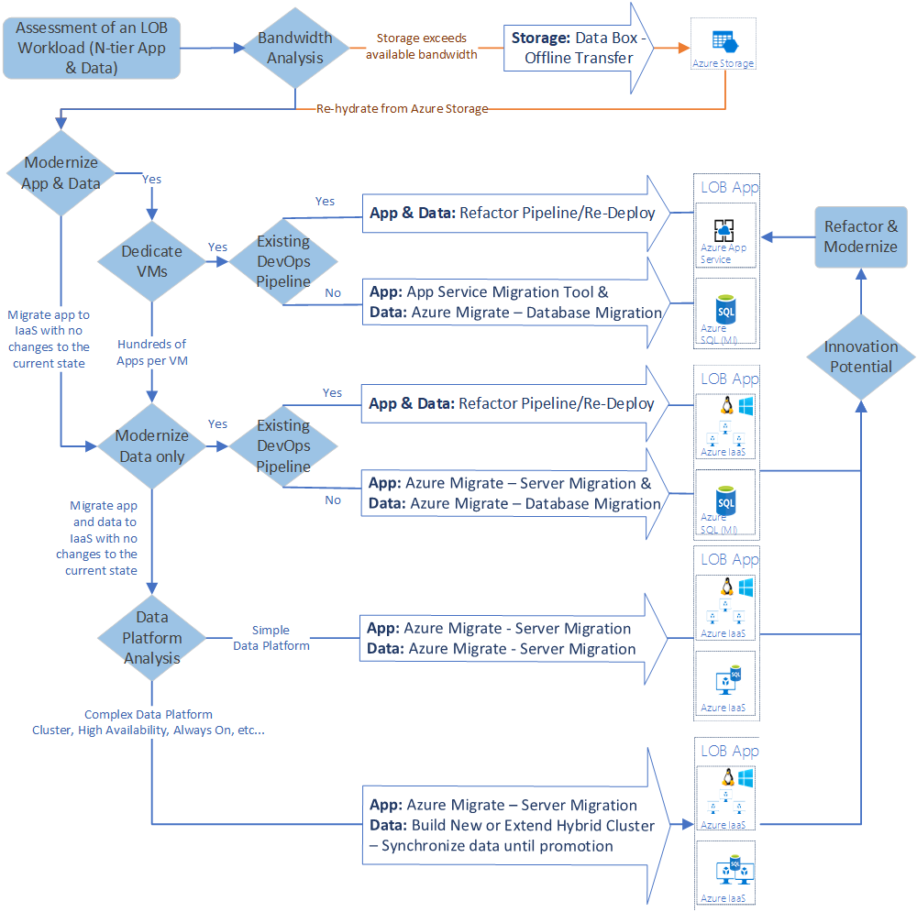
Migration tools decision guide

Slide 29
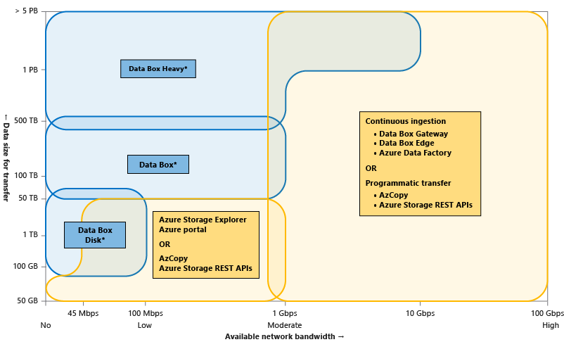
Choose the various Azure data transfer tools

Slide 30
Selecting the Right Offline Data Transfer Solutions
 | Data Box Disk | Data Box | Data Box Heavy | Import/Export
Data size | Up to 35 TBs | Up to 80 TBs per device | Up to 800 TB per device | Variable
Data type | Azure Blobs | Azure Blobs Azure Files | Azure Blobs Azure Files | Azure Blobs Azure Files
Form factor | 5 SSDs per order | 1 X 50-lbs. desktop-sized device per order | 1 X ~500-lbs. large device per order | Up to 10 HDDs/SSDs per order
Initial setup time | Low (15 mins) | Low to moderate (<30 mins) | Moderate (1-2 hours) | Moderate to difficult (variable)
Send data to Azure | Yes | Yes | Yes | Yes
Export data from Azure | No | No | No | Yes
Encryption | AES 128-bit | AES 256-bit | AES 256-bit | AES 128-bit
Hardware | Microsoft supplied | Microsoft supplied | Microsoft supplied | Customer supplied
Network interface | USB 3.1/SATA | RJ 45, SFP+ | RJ45, QSFP+ | SATA II/SATA III
Partner integration | Some | High | High | Some
Shipping | Microsoft managed | Microsoft managed | Microsoft managed | Customer managed
Use when data moves | Within a commerce boundary | Within a commerce boundary | Within a commerce boundary | Across geographic boundaries, e.g. US to EU
https://docs.microsoft.com/en-us/azure/storage/common/storage-solution-large-dataset-moderate-high-network

Slide 31
Selecting the Right Online Data Transfer Solutions
 | Tools AzCopy, Azure PowerShell, Azure CLI | Azure Storage REST APIs, SDKs | Data Box Gateway or Data Box Edge | Azure Data Factory
Data type | Azure Blobs, Azure Files, Azure Tables | Azure Blobs, Azure Files, Azure Tables | Azure Blobs, Azure Files | Supports 70+ data connectors for data stores and formats
Form factor | Command-line tools | Programmatic interface | Microsoft supplies a virtual or physical device | Service in Azure portal
Initial one-time setup | Easy | Moderate | Easy (<30 minutes) to moderate (1-2 hours) | Extensive
Data pre-processing | No | No | Yes (With Edge compute) | Yes
Transfer from other clouds | No | No | No | Yes
User type | IT Pro or dev | Dev | IT Pro | IT Pro
https://docs.microsoft.com/en-us/azure/storage/common/storage-solution-large-dataset-moderate-high-network

Slide 32
Additional Slides

Slide 33
Useful Links
Azure Introduction – Tenants, Subscriptions, Guidance on Naming Conventions, IP Addressing, Important facts to understand before planning your virtual DC
Getting started with Microsoft Azure security – How Azure Stores Customer Info in various PaaS, IaaS and other scenarios
Azure subscription and service limits, quotas, and constraints
List of supported software on Azure
Azure Pricing Calculator (Channel Partners, Customers)
Monitoring
Sources of monitoring data in Azure
Collecting monitoring data in Azure
Multi-customer monitoring with Azure Log Analytics (MSPs/Service Providers)
*Refer to the notes section for important facts on Azure , will be useful for planning your virtual DC
Notes:
Mesh and Hub-and-Spoke Networks on Azure: Architectural Considerations for Virtual Network Peering
Microsoft Azure Datacenter IP Ranges Microsoft Public IP Space Network infrastructure requirements for Microsoft Intune Power BI and ExpressRoute Office 365 URLs and IP address ranges Managing ExpressRoute for Office 365 connectivity Office 365 Network Connectivity Principles
Managing Office 365 End Points: https://support.office.com/en-us/article/managing-office-365-endpoints-99cab9d4-ef59-4207-9f2b-3728eb46bf9a?ui=en-US&rs=en-US&ad=US#ID0EACAAA=0._Overview

Slide 34
Which Solution to Use for Web Apps?
IF YOU WANT TO... | USE THIS
Build on a fully-managed platform to:Develop and deploy web apps at any scale using .Net Core, Java, Docker, Node.js, and more. Launch websites quickly, with broad CMS support from the Azure Marketplace. Accelerate your feature updates using built-in CI/CD. | App Service
Accelerate the delivery of high-bandwidth content—from applications and stored content to streaming video—to customers worldwide. | Content Delivery Network
Encode, store, and stream video and audio at scale. Deliver broadcast and over-the-top (OTT) video. Use media analytics to gain insights about video files. | Media Services
Implement a fully-managed search service that helps you avoid issues with index corruption, scaling, service availability, and service. | Azure Search
Add real-time functionality to your web app, such as chat room, co-authoring, live dashboard, and instant broadcasting. | Azure SignalR Service
Add maps, search, routing, and current traffic conditions to your apps with geospatial services. | Azure Maps
Ensure ultra-fast DNS responses and ultra-high availability for all your domain needs. | Azure DNS
Optimize delivery from application server farms while increasing application security with a web application firewall. | Application Gateway

Slide 35
Criteria for choosing an Azure compute service
Criteria | Virtual Machines | App Service | Service Fabric | Azure Functions | Azure Kubernetes Service | Container Instances | Azure Batch
SLA | SLA for Virtual Machines | SLA for App Service | SLA for Service Fabric | SLA for Functions | SLA for AKS | SLA for Container Instances | SLA for Azure Batch
Multi region failover | Traffic manager | Traffic manager | Traffic manager, Multi-Region Cluster | Not supported | Traffic manager | Not supported | Not Supported
Criteria | Virtual Machines | App Service | Service Fabric | Azure Functions | Azure Kubernetes Service | Container Instances | Azure Batch
SSL | Configured in VM | Supported | Supported | Supported | Ingress controller | Use sidecarcontainer | Supported
Cost | Windows, Linux | App Service pricing | Service Fabric pricing | Azure Functions pricing | AKS pricing | Container Instances pricing | Azure Batch pricing
Suitable architecture styles | N-Tier, Big compute(HPC) | Web-Queue-Worker, N-Tier | Microservices, Event-driven architecture | Microservices, Event-driven architecture | Microservices, Event-driven architecture | Microservices, task automation, batch jobs | Big compute(HPC)

Slide 36
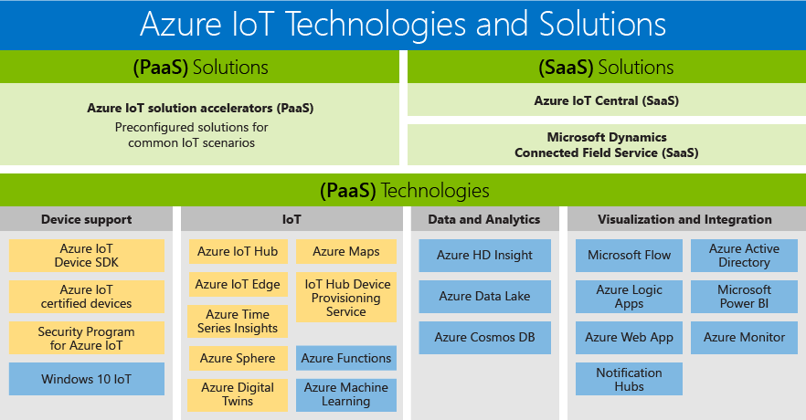
Which Solution to Use for Internet of Things?
IF YOU WANT TO... | USE THIS
Experience fully managed software as a service for IoT—no cloud expertise required | Azure IoT Central
Customize solution templates for common IoT scenarios | Azure IoT solution accelerators
Extend intelligence from the cloud to your edge devices | Azure IoT Edge
Connect, monitor, and control billions of IoT assets | Azure IoT Hub
Create a digital model of your physical space or assets | Azure Digital Twins
Explore and gain insights from time-series IoT data in real time | Azure Time Series Insights
Build and connect highly secure MCU-powered devices | Azure Sphere
Simple and secure location APIs provide geospatial context to data | Azure Maps

Slide 37
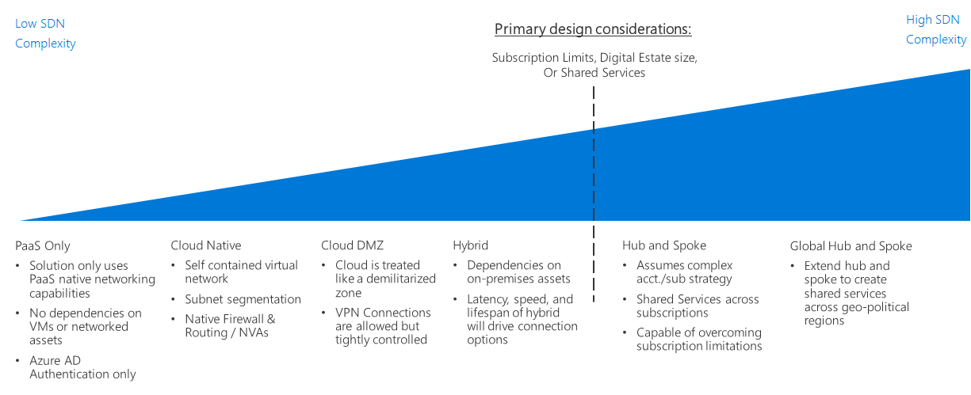
Software Defined Networking decision guide
Notes:
https://docs.microsoft.com/en-us/azure/architecture/cloud-adoption/decision-guides/software-defined-network/index
Software Defined Networking (SDN) is a network architecture designed to allow virtualized networking functionality that can be centrally managed, configured, and modified through software. SDN enables the creation of cloud-based networks using the virtualized equivalents to physical routers, firewalls, and other networking devices used in on-premises networks. SDN is critical to creating secure virtual networks on public cloud platforms such as Azure.

